Slide 1
Prioritize
Joel Wilhelm Cody Jones Wajahat Iqbal Shahrukh Rehman

Slide 2
Project Goals
Create a useful mobile application to assist others
Learn a new platform for programming
Learn the process of mobile application development

Slide 3
Project Requirements
Prioritize must -
Be simple, easy to use, quick to understand.
Remind the user of their event at an appropriate time
Be able to save, load, edit, and delete reminder information
Be able to sync to other devices the user owns
(Any more?)

Slide 4
Overall System
Android App
Google Drive

Slide 5
Overall System
(Android App)
Android App
Google Drive
Android App
Notification
UI
SQLite Database
Priority Algorithm
JSON

Slide 6
Priority Algorithm
Notification
UI
SQLite Database
Priority Algorithm
JSON
Backbone of Prioritize.
Current Date + Current Time + Due Date + Due Time + Priority Value = Calculated Remind Date + Calculated Remind Time
An interval of 5 Priority Values determines how soon the user will receive a reminder.

Slide 7
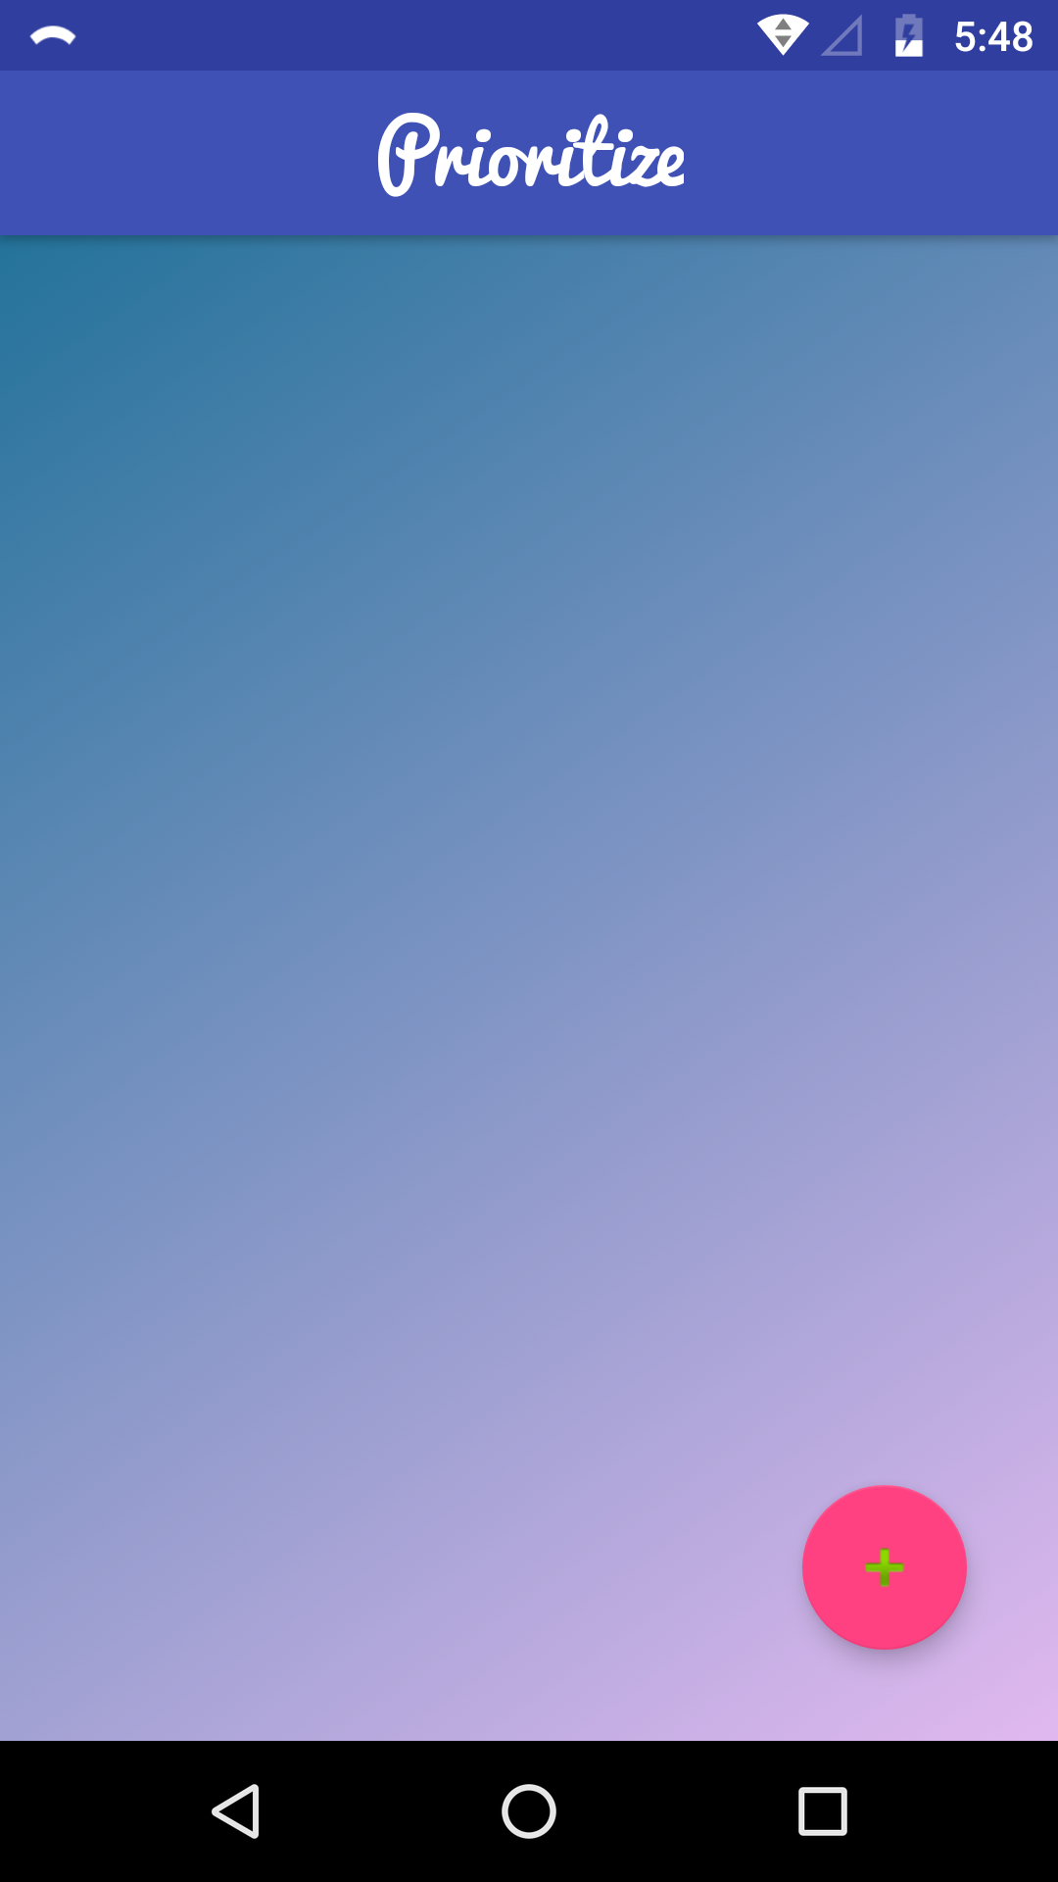
UI
Notification
Notification
UI
UI
SQLite Database
SQLite Database
Priority Algorithm
Priority Algorithm
JSON
JSON
Name of Application

Slide 8
UI
Notification
Notification
UI
UI
SQLite Database
SQLite Database
Priority Algorithm
Priority Algorithm
JSON
JSON
List of Notifications will be shown here

Slide 9
UI
Notification
Notification
UI
UI
SQLite Database
SQLite Database
Priority Algorithm
Priority Algorithm
JSON
JSON
Add a Reminder Button

Slide 10
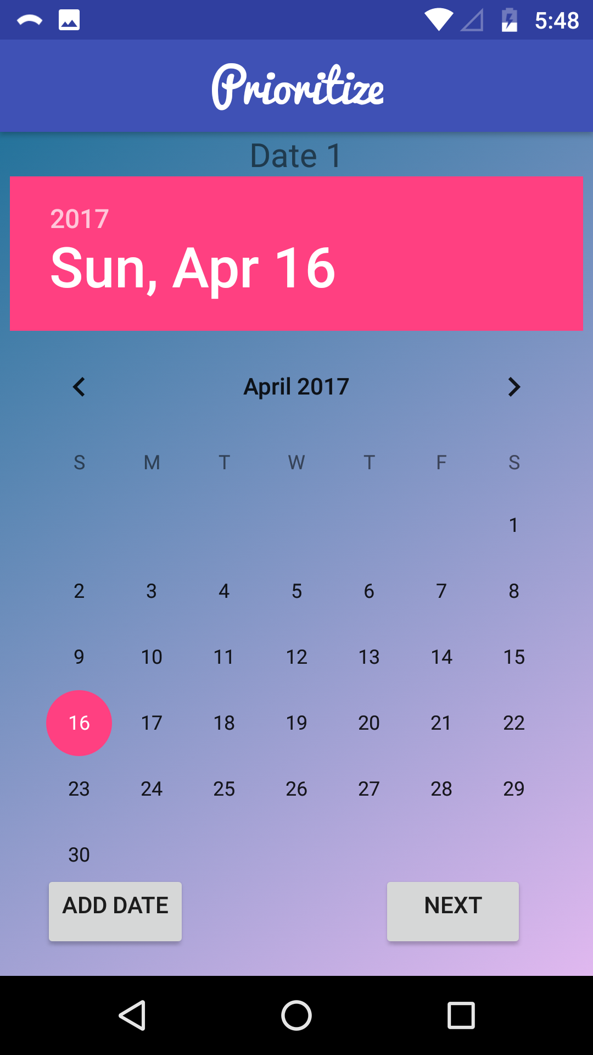
UI
Notification
Notification
UI
UI
SQLite Database
SQLite Database
Priority Algorithm
Priority Algorithm
JSON
JSON
Allows you to select the date your Reminder is due

Slide 11
UI
Notification
Notification
UI
UI
SQLite Database
SQLite Database
Priority Algorithm
Priority Algorithm
JSON
JSON
Add an additional date, or move to the next part.

Slide 12
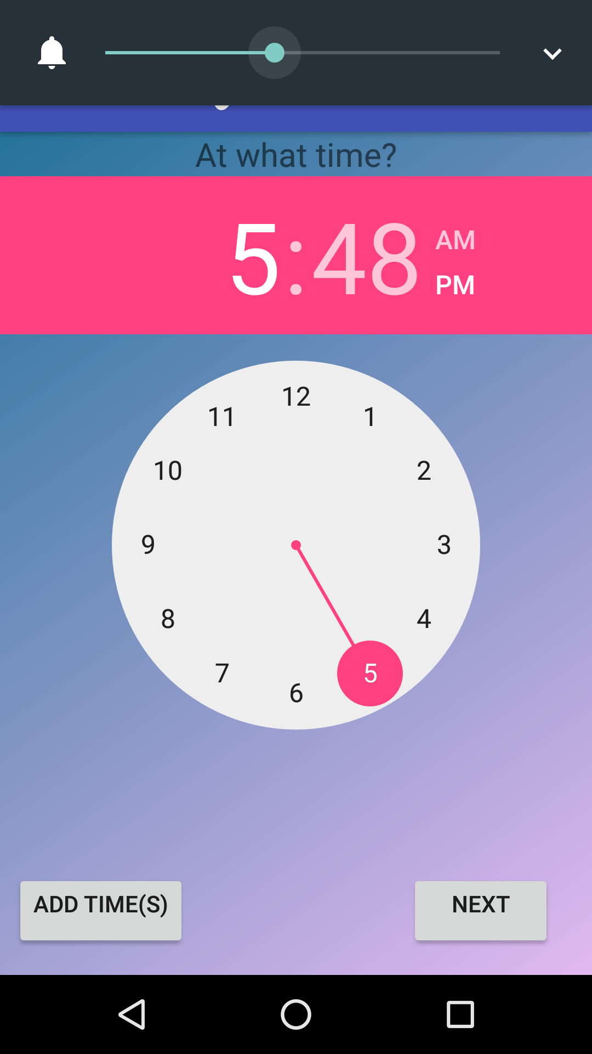
UI
Notification
Notification
UI
UI
SQLite Database
SQLite Database
Priority Algorithm
Priority Algorithm
JSON
JSON
Select the Time the reminder is due

Slide 13
UI
Notification
Notification
UI
UI
SQLite Database
SQLite Database
Priority Algorithm
Priority Algorithm
JSON
JSON
Add an additional time, or move to the next part.

Slide 14
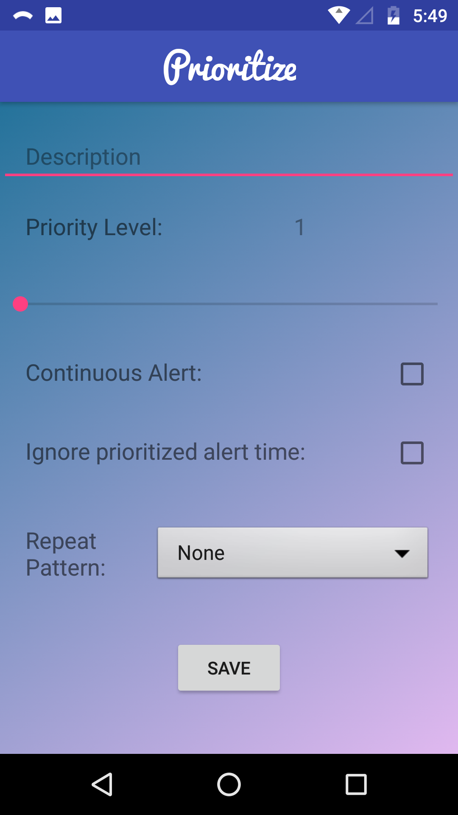
UI
Notification
Notification
UI
UI
SQLite Database
SQLite Database
Priority Algorithm
Priority Algorithm
JSON
JSON
Enter Description of your Event here

Slide 15
UI
Notification
Notification
UI
UI
SQLite Database
SQLite Database
Priority Algorithm
Priority Algorithm
JSON
JSON
Slide the bar to select Priority Level

Slide 16
UI
Notification
Notification
UI
UI
SQLite Database
SQLite Database
Priority Algorithm
Priority Algorithm
JSON
JSON
Check these boxes for other options - Needing user to turn off alarm / set alarm off at designated time, ignoring Priority

Slide 17
UI
Notification
Notification
UI
UI
SQLite Database
SQLite Database
Priority Algorithm
Priority Algorithm
JSON
JSON
Repeat every X days?

Slide 18
UI
Notification
Notification
UI
UI
SQLite Database
SQLite Database
Priority Algorithm
Priority Algorithm
JSON
JSON
Save the Reminder!

Slide 19
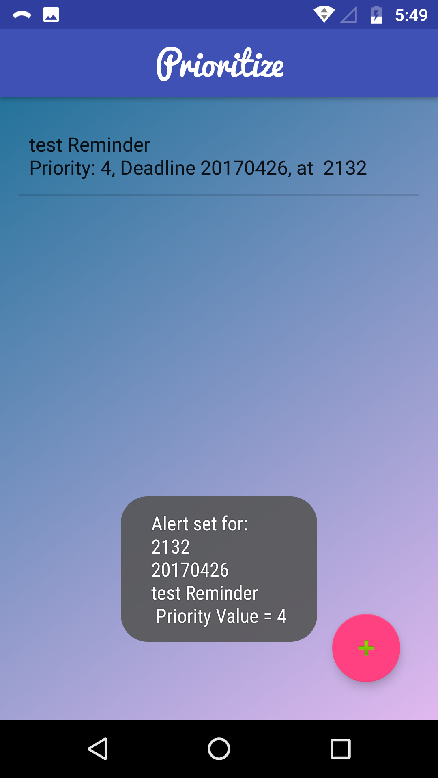
UI
Notification
Notification
UI
UI
SQLite Database
SQLite Database
Priority Algorithm
Priority Algorithm
JSON
JSON
Edit or Delete Reminder

Slide 20
UI
Notification
Notification
UI
UI
SQLite Database
SQLite Database
Priority Algorithm
Priority Algorithm
JSON
JSON
Message to inform user when their reminder is set.
21:32
April 26, 2017.

Slide 21
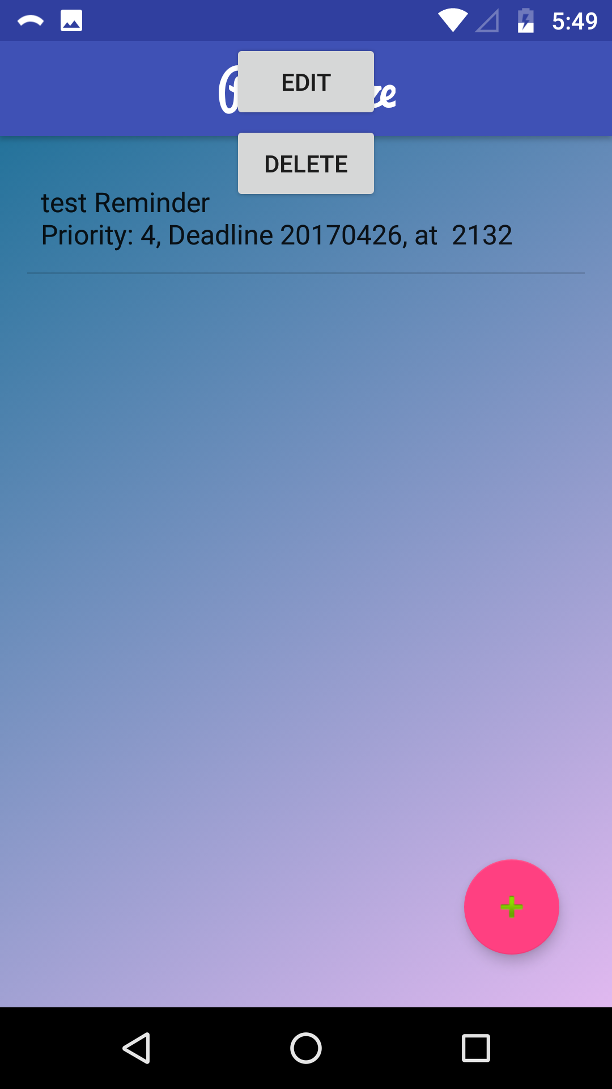
UI
Notification
Notification
UI
UI
SQLite Database
SQLite Database
Priority Algorithm
Priority Algorithm
JSON
JSON
Edit or Delete Reminder

Slide 22
SQLite Database
Notification
Notification
UI
UI
SQLite Database
SQLite Database
Priority Algorithm
Priority Algorithm
JSON
JSON
Database implemented in SQLite
(Add more here)

Slide 23
JSON Object
Notification
Notification
UI
UI
SQLite Database
SQLite Database
Priority Algorithm
Priority Algorithm
JSON
JSON
Object whose fields are all the bits of data to be stored in the SQLite Database
Also has a field called “JSONString”
This String gets stored in SQLite Database
A parser method
Takes the String loaded from the Database, creates JSON object from it

Slide 24
Notifications
Notification
Notification
UI
UI
SQLite Database
SQLite Database
Priority Algorithm
Priority Algorithm
JSON
JSON
Two types of Notifications:
Alerts
A simple tone, letting the user know of their Reminder
Alarms
Needs user’s acknowledgement, or won’t stop ringing
Created by the App, using Android’s notifications.
Notifications have 3 options:
Snooze
Remind Me Later
Don’t Remind Me Again

Slide 25
Data IO

Slide 26
Demonstration

Slide 27
Future Plans for Improvement
Add a Geolocation / Geofencing Feature
Can set alarms/reminders based on a particular location
Work on “un-cluttering” the Google Drive Folder
Tidying up the UI
Add a timer / stopwatch feature

